Slide 1
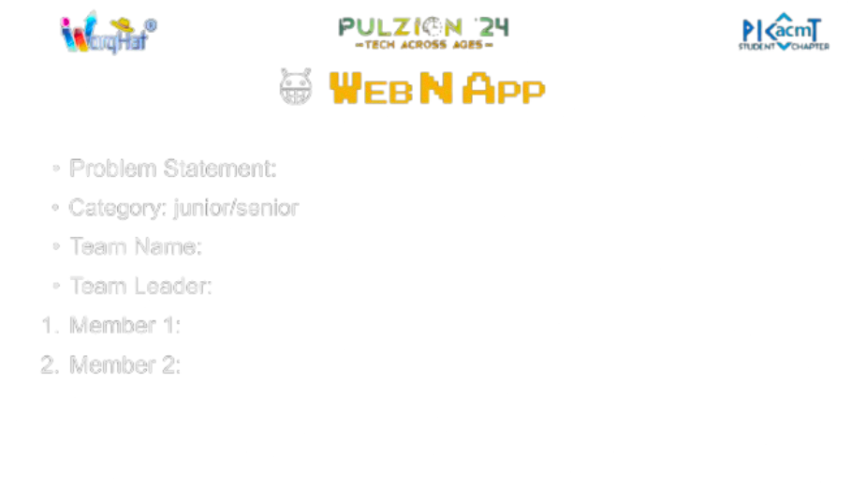


AI QUIZ GENERATOR
Transforming learning with AI-powered quizzes and assessments(Junior).
click to visit
Team : Code Crafters
Team Lead : Anuj Loharkar.
Team member : Swaraj Mahadik.
Team member : Mukul Agrawal

Slide 2
Overview of the Solution:
How it Addresses the Problem:
Innovation and Uniqueness:
AI-driven quiz and content generation based on syllabus or curriculum.
Personalized, adaptive learning paths for students.
Instant feedback and detailed performance analytics.
Web application with classroom management features.
Automates quiz creation from teaching materials (PDFs, Word docs).
Saves teachers' time by covering key topics efficiently.
Simplifies grading and tracks student progress over time.
Provides a user-friendly interface for teachers to create and manage quizzes.
AI-generated diverse question types based on document content.
Adaptive learning paths tailored to individual student needs.
Instant feedback with comprehensive performance analytics.
Integrates classroom management for enhanced student tracking and engagement.

Slide 3

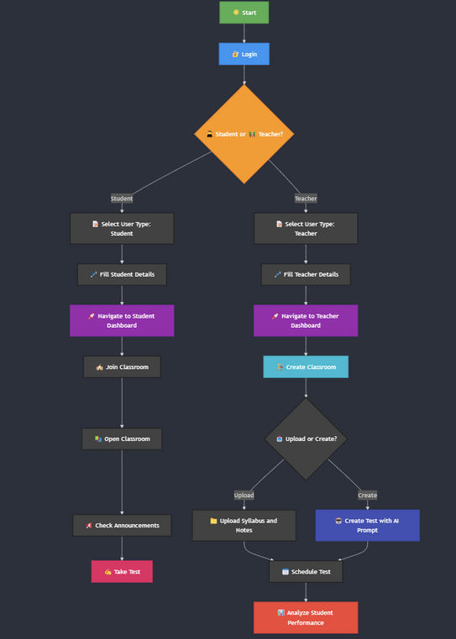
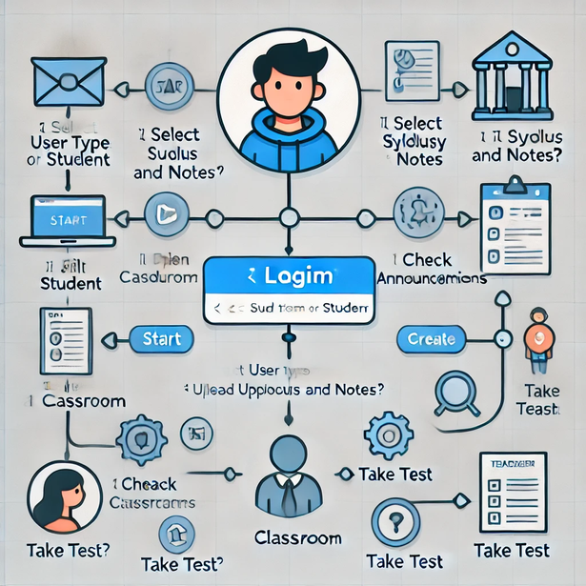






Slide 4
Key Technologies/Frameworks:
Key Algorithms/Processes:
Integration & Scalability:
Frontend: React.js
Backend: Node.js with Express.js
Database: MongoDB
AI Tools: NLP for quiz generation
UI Libraries: Tailwind CSS
Authentication: JWT
Cloud Services: AWS/Google Cloud for hosting and scalability
Integration: RESTful APIs connect frontend with backend and AI tools.
Scalability: Cloud infrastructure and microservices architecture ensure seamless scaling for increased users and workloads.
Question Generation: NLP extracts topics and creates quiz questions.
Adaptive Learning: Algorithm customizes learning paths based on performance.
Grading: Auto-grades quizzes and provides real-time feedback.
Performance Analytics: Tracks and analyzes progress, offering insights.

Slide 5
Feasibility Analysis:
The idea is feasible with current technologies like NLP for quiz generation, adaptive learning algorithms, and scalable cloud infrastructure. Developing a user-friendly platform for both teachers and students is achievable using proven web development frameworks (React, Node.js).
Strategies for Overcoming Challenges:
NLP Tuning: Continuously improve NLP models with feedback loops to ensure high accuracy in question generation.
Cloud Scaling: Implement auto-scaling and load-balancing strategies to manage high traffic.
Data Security: Use encryption, secure authentication (JWT), and compliance with data privacy regulations (e.g., GDPR).
User Training: Offer tutorials and onboarding sessions to ease the adoption process for new users.
Potential Challenges and Risks:
NLP Accuracy: Difficulty in accurately generating contextually relevant questions from diverse educational materials.
Scalability: Handling high user traffic, especially during peak usage times (e.g., exam periods).
Data Privacy: Ensuring secure storage and management of student and teacher data.
User Adoption: Resistance from teachers or institutions unfamiliar with tech-based solutions.

Slide 6
